Slide 1
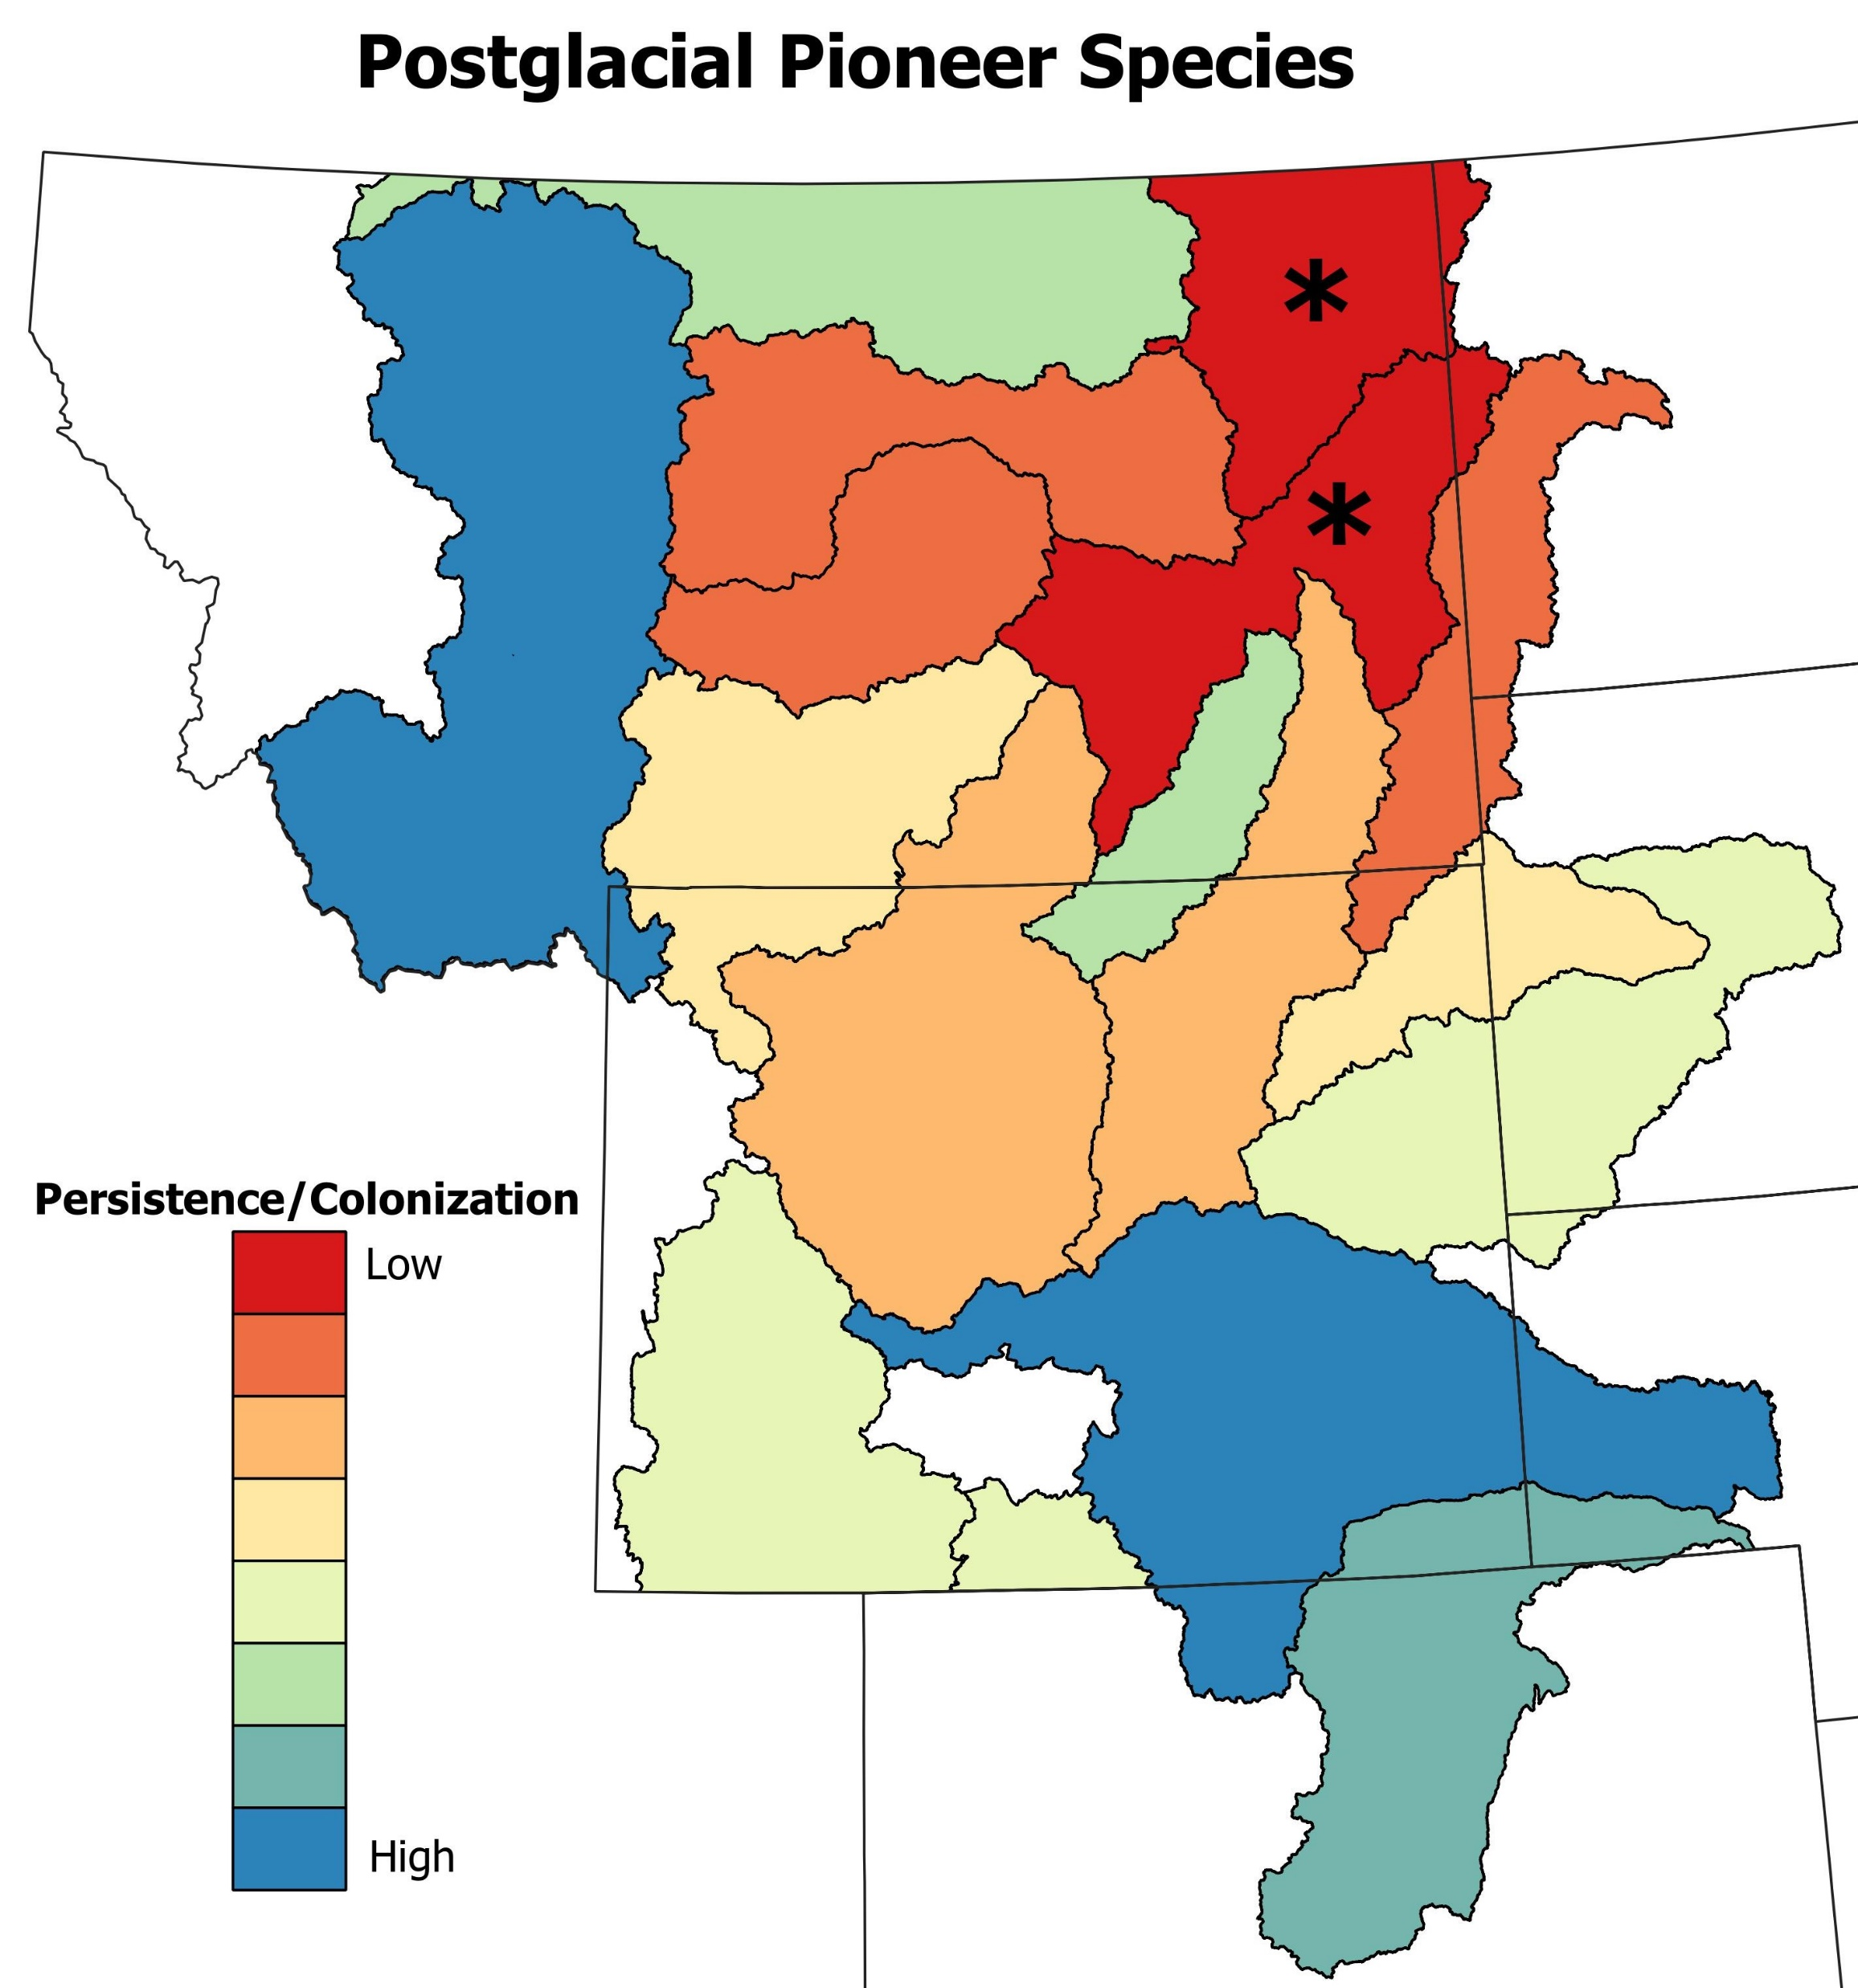
A. Native Species Persistence
B. Community Turnover
C. Postglacial Pioneer Species Refugia
F. Postglacial Pioneer Persistence

